Slide 1
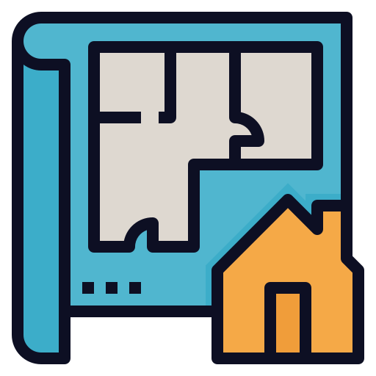



ARIADNE:
A General Purpose
Indoor Navigation System
Developed by undergraduate students
from the National Technical University of Athens
HiPEAC Student Challenge – 21/01/2025

Slide 2
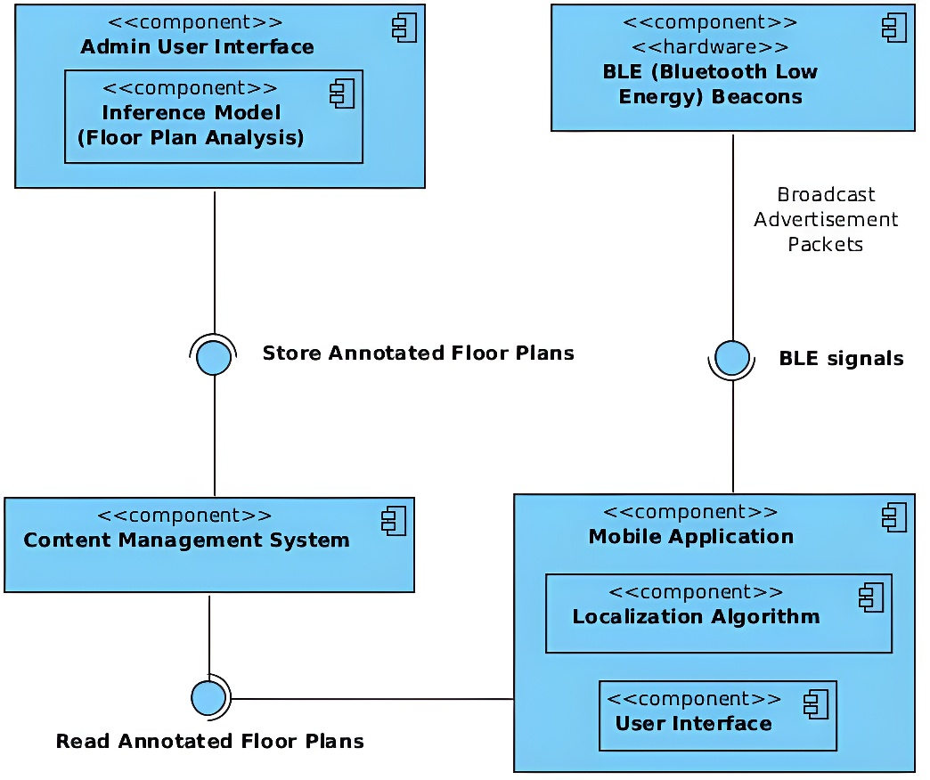
ARIADNE System Architecture
ARIADNE - NTUA
1

Slide 3


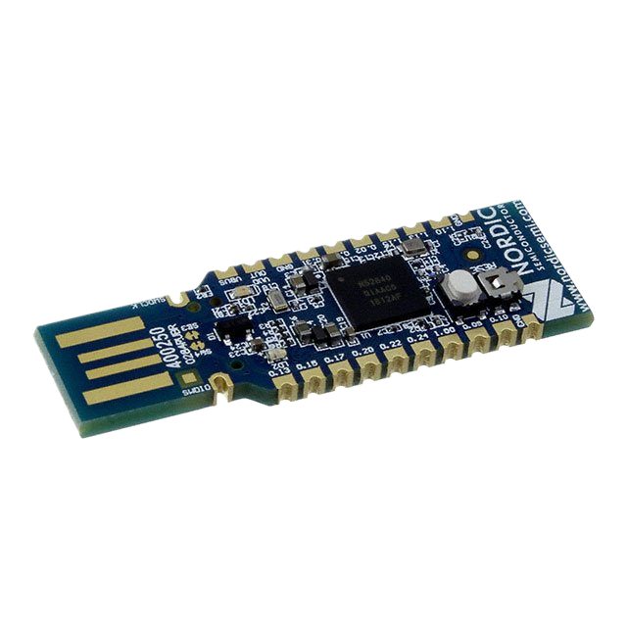
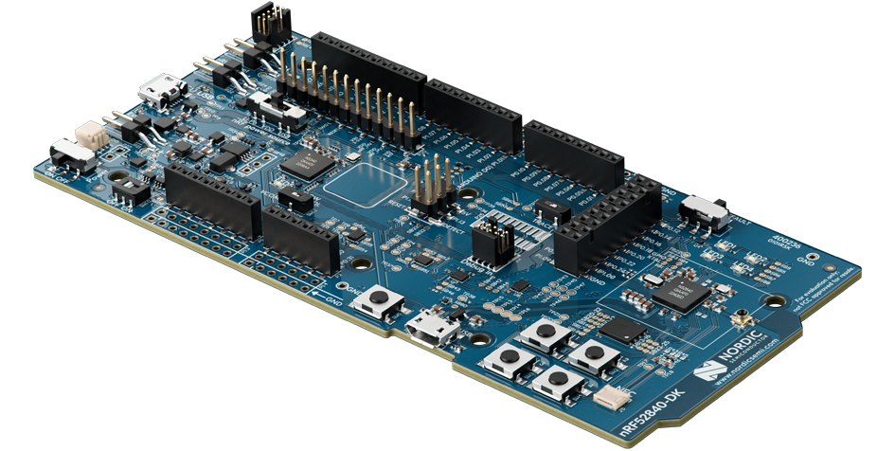

Bluetooth beacons
Why use beacons?
What are beacons?
RSSI for location estimation
BLE support
continuous operation on a single battery for extended time
compact devices
periodical signal transmission
reaching nearby devices
Which beacons?
Nordic Semiconductors nRF52840 SoC
fine-tuned control over range and energy consumption
ARIADNE - NTUA
2

Slide 4
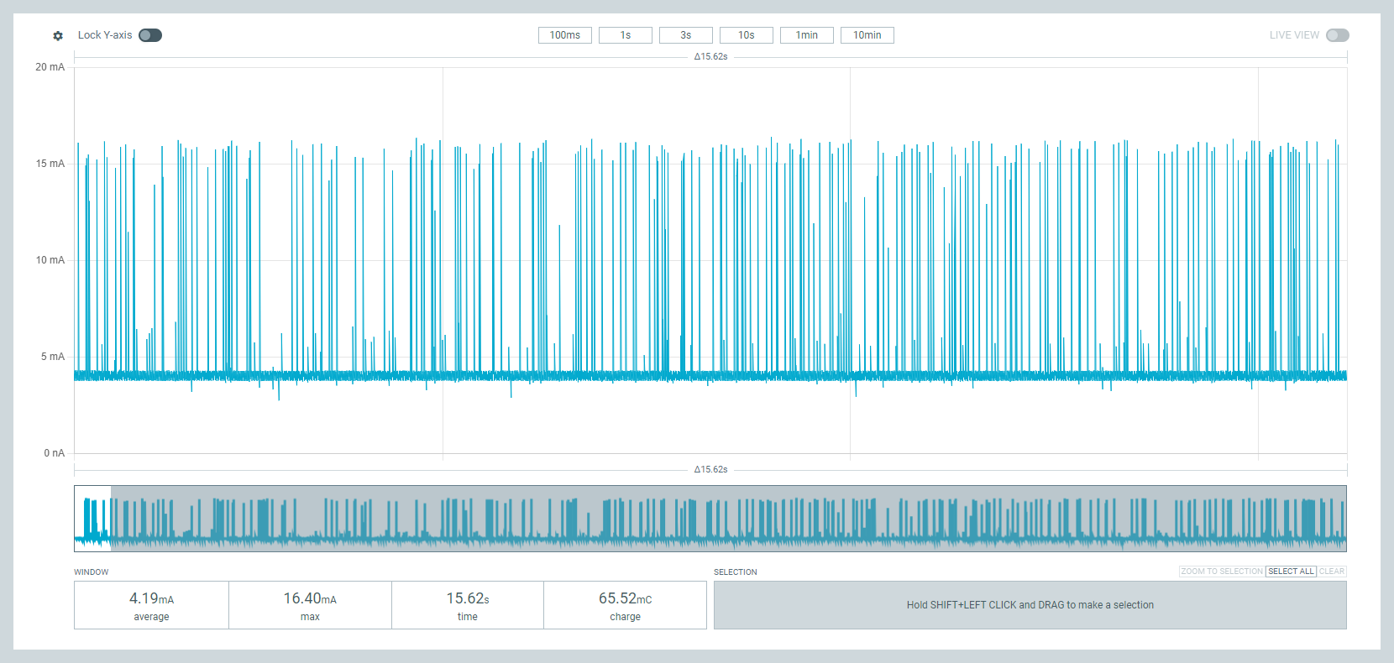
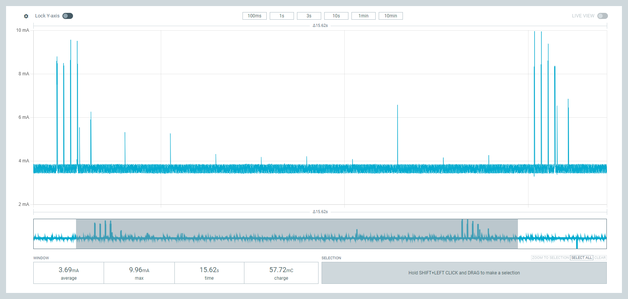
Classic beacon VS ARIADNE beacon
Advertising packets every 100ms
continuous operation
no logic needed
receiving packets from devices
logic to decide whether to advertise packets or enter sleep mode
ARIADNE - NTUA
3

Slide 5
ARIADNE beacon details
Advertising
Interrupting
BLE signal transmission
100ms interval
same as “classic” beacon
utilization of Timer
when packets are received
interrupt every 2s
continuously receiving signals
interval < 1s
filters out unwanted packets
when receiving 0 packets
no advertising
dynamically changing duration
Observing
Sleeping
ARIADNE - NTUA
4

Slide 6
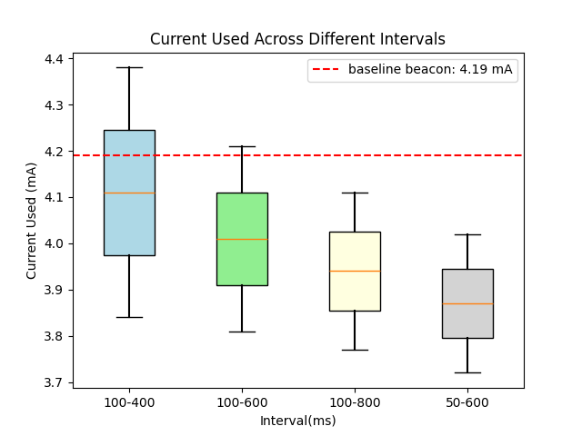
Power Efficiency
supply voltage 3.8V
observation interval =
scan window + waiting duration
min. current used on sleep mode
max. current used when receiving
packets for consecutive time periods
average current : 3.85mA
ARIADNE - NTUA
5

Slide 7
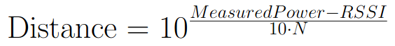
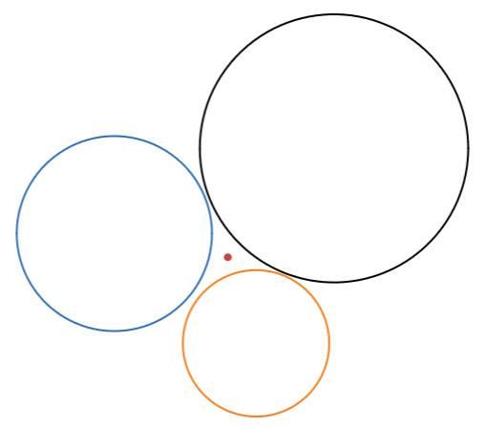
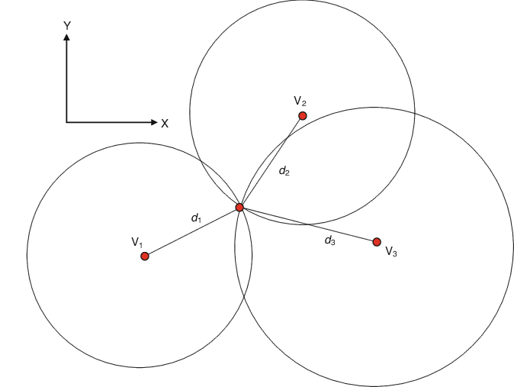
Localization Algorithm
RSSI : Received Signal Strength Indicator
Measured Power : factory-calibrated constant
N : obstacle density of building
Simple Trilateration
Least Squares method
ARIADNE - NTUA
6

Slide 8
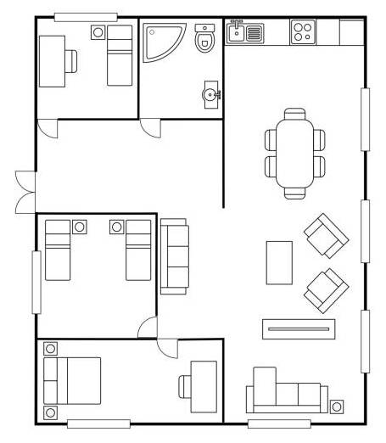

Floor Plan Analysis
Detect the walkable space and construct a navigation graph
Important Components
Doors
YOLO11 CNN
Walls/
Obstacles
Computer Vision
Rooms
YOLOv8 CNN
ARIADNE - NTUA
7

Slide 9
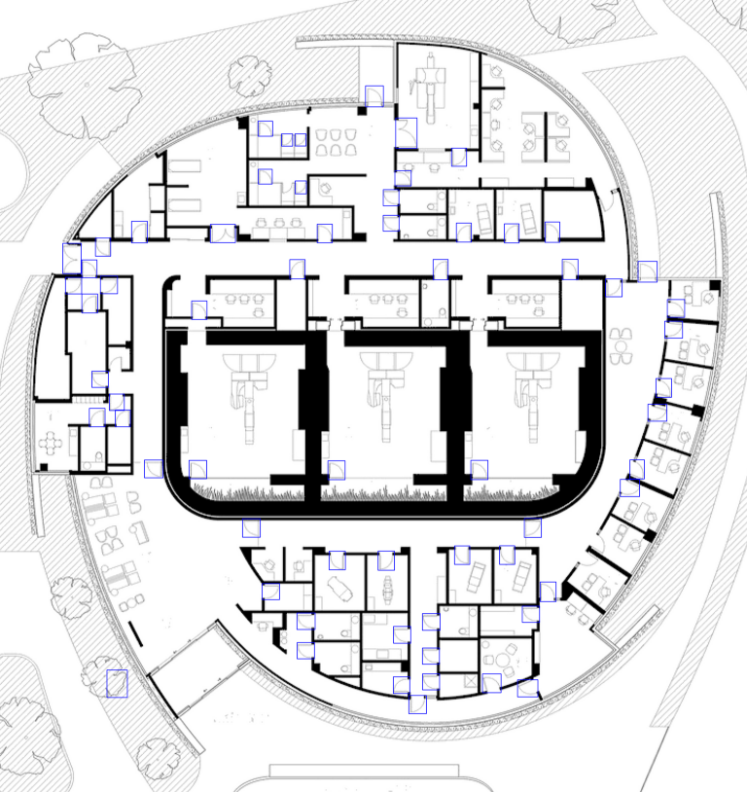
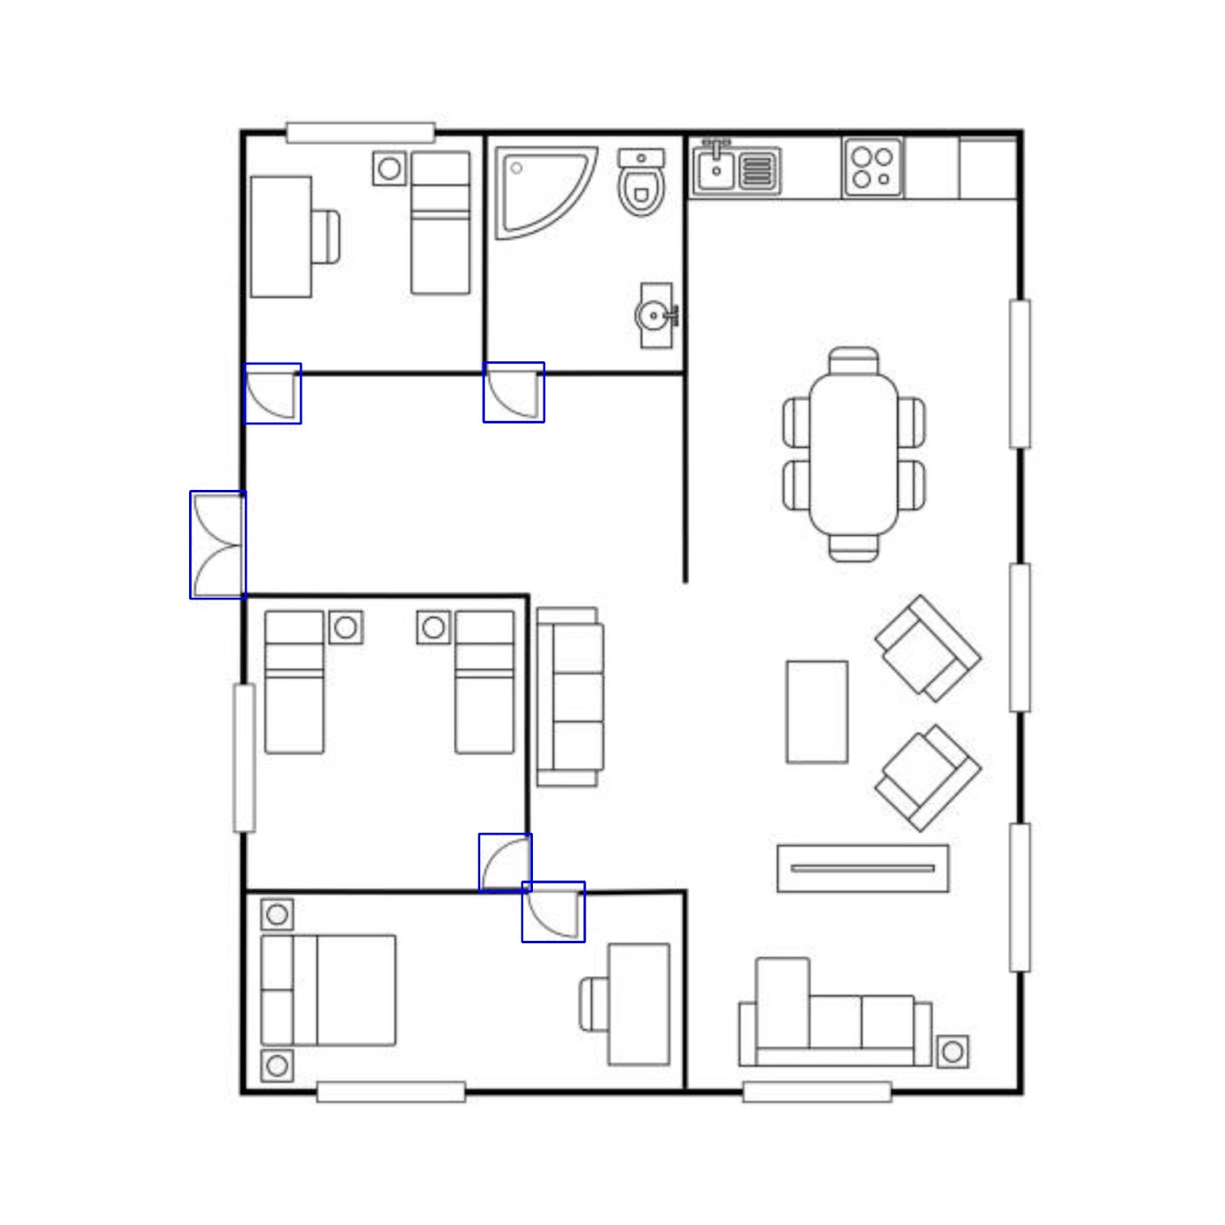
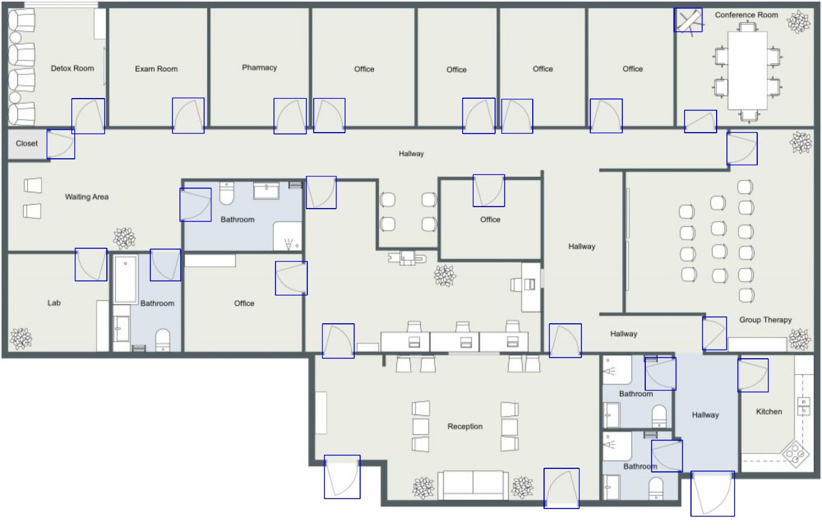
Door Detection
Use of YOLO11 CNN model with bounding box detection
ARIADNE - NTUA
8

Slide 10
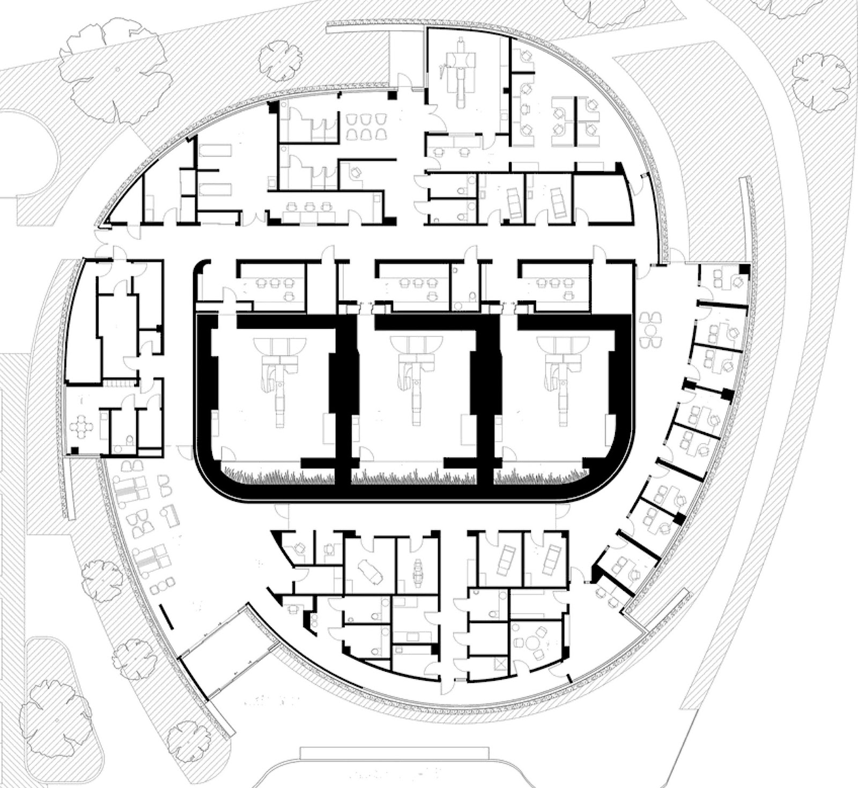
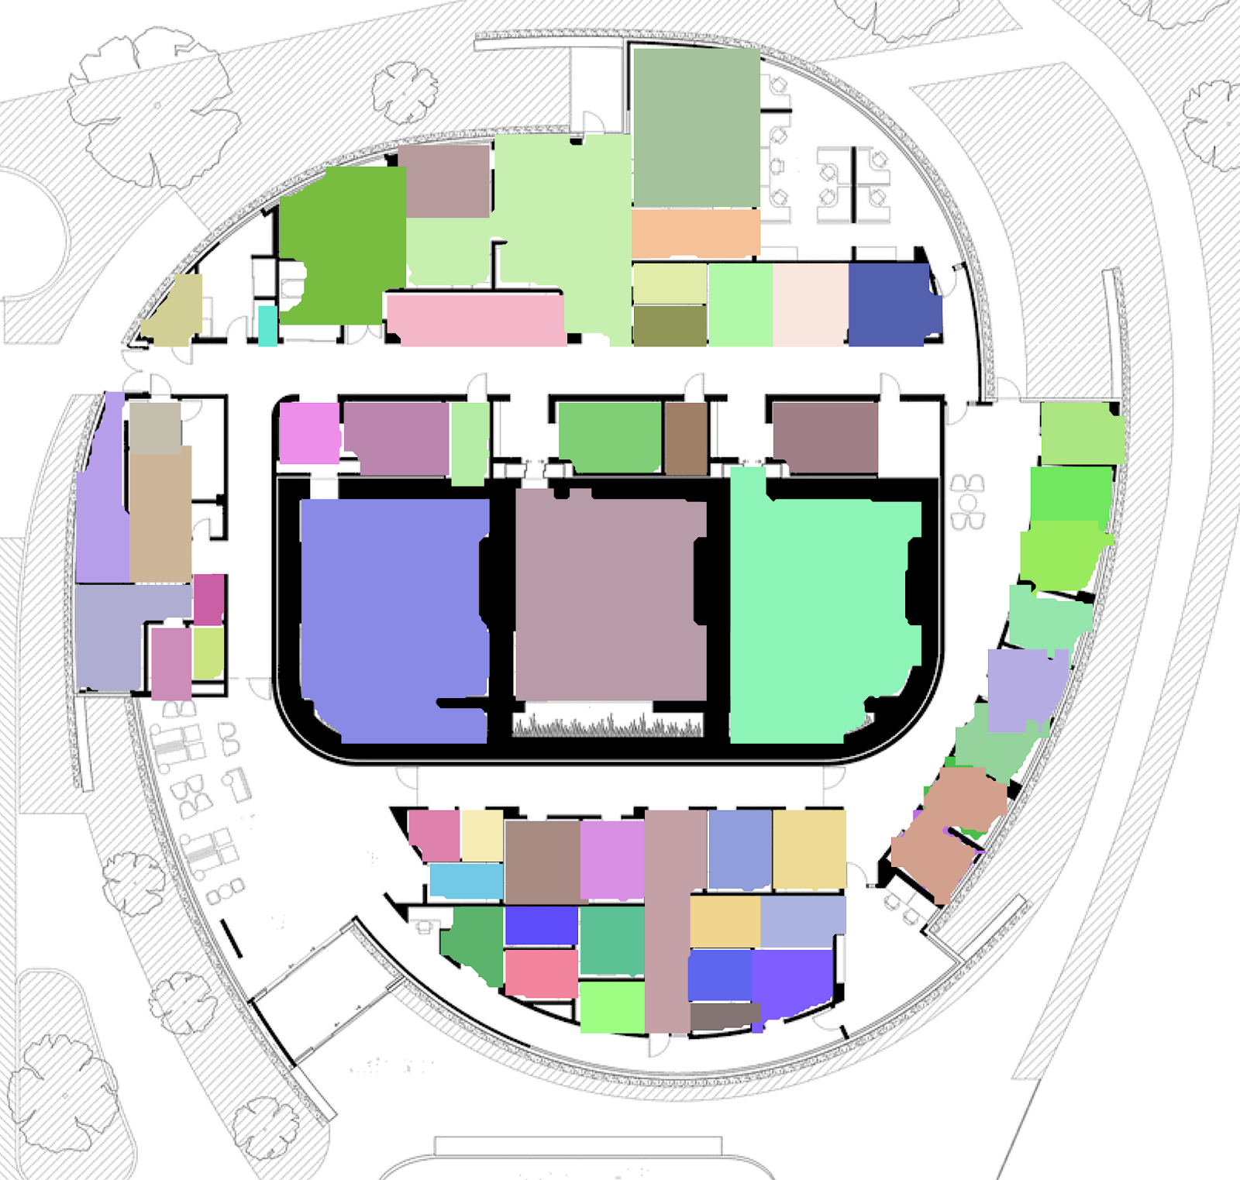
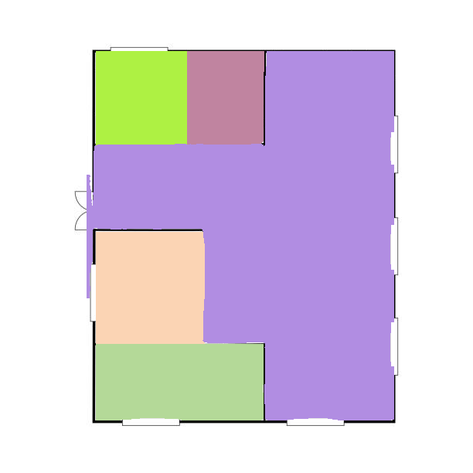
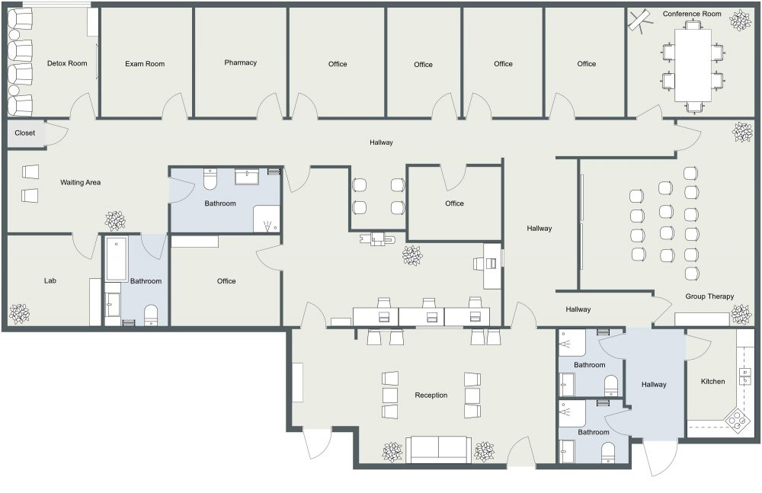
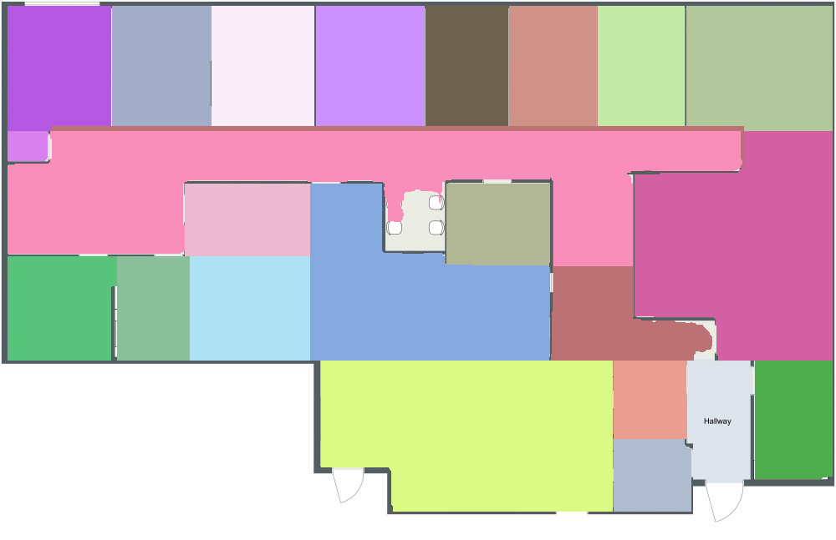
Room Detection
Use of YOLOv8 CNN model with instance segmentation
9

Slide 11
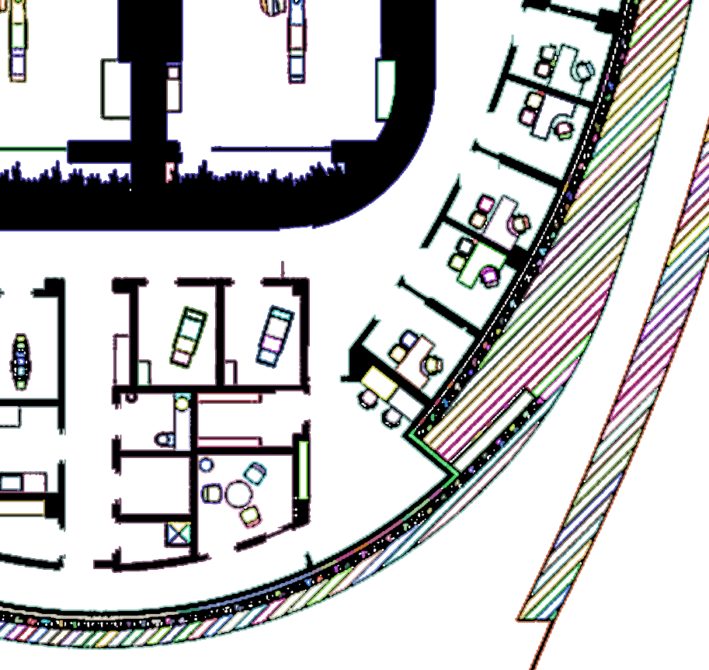


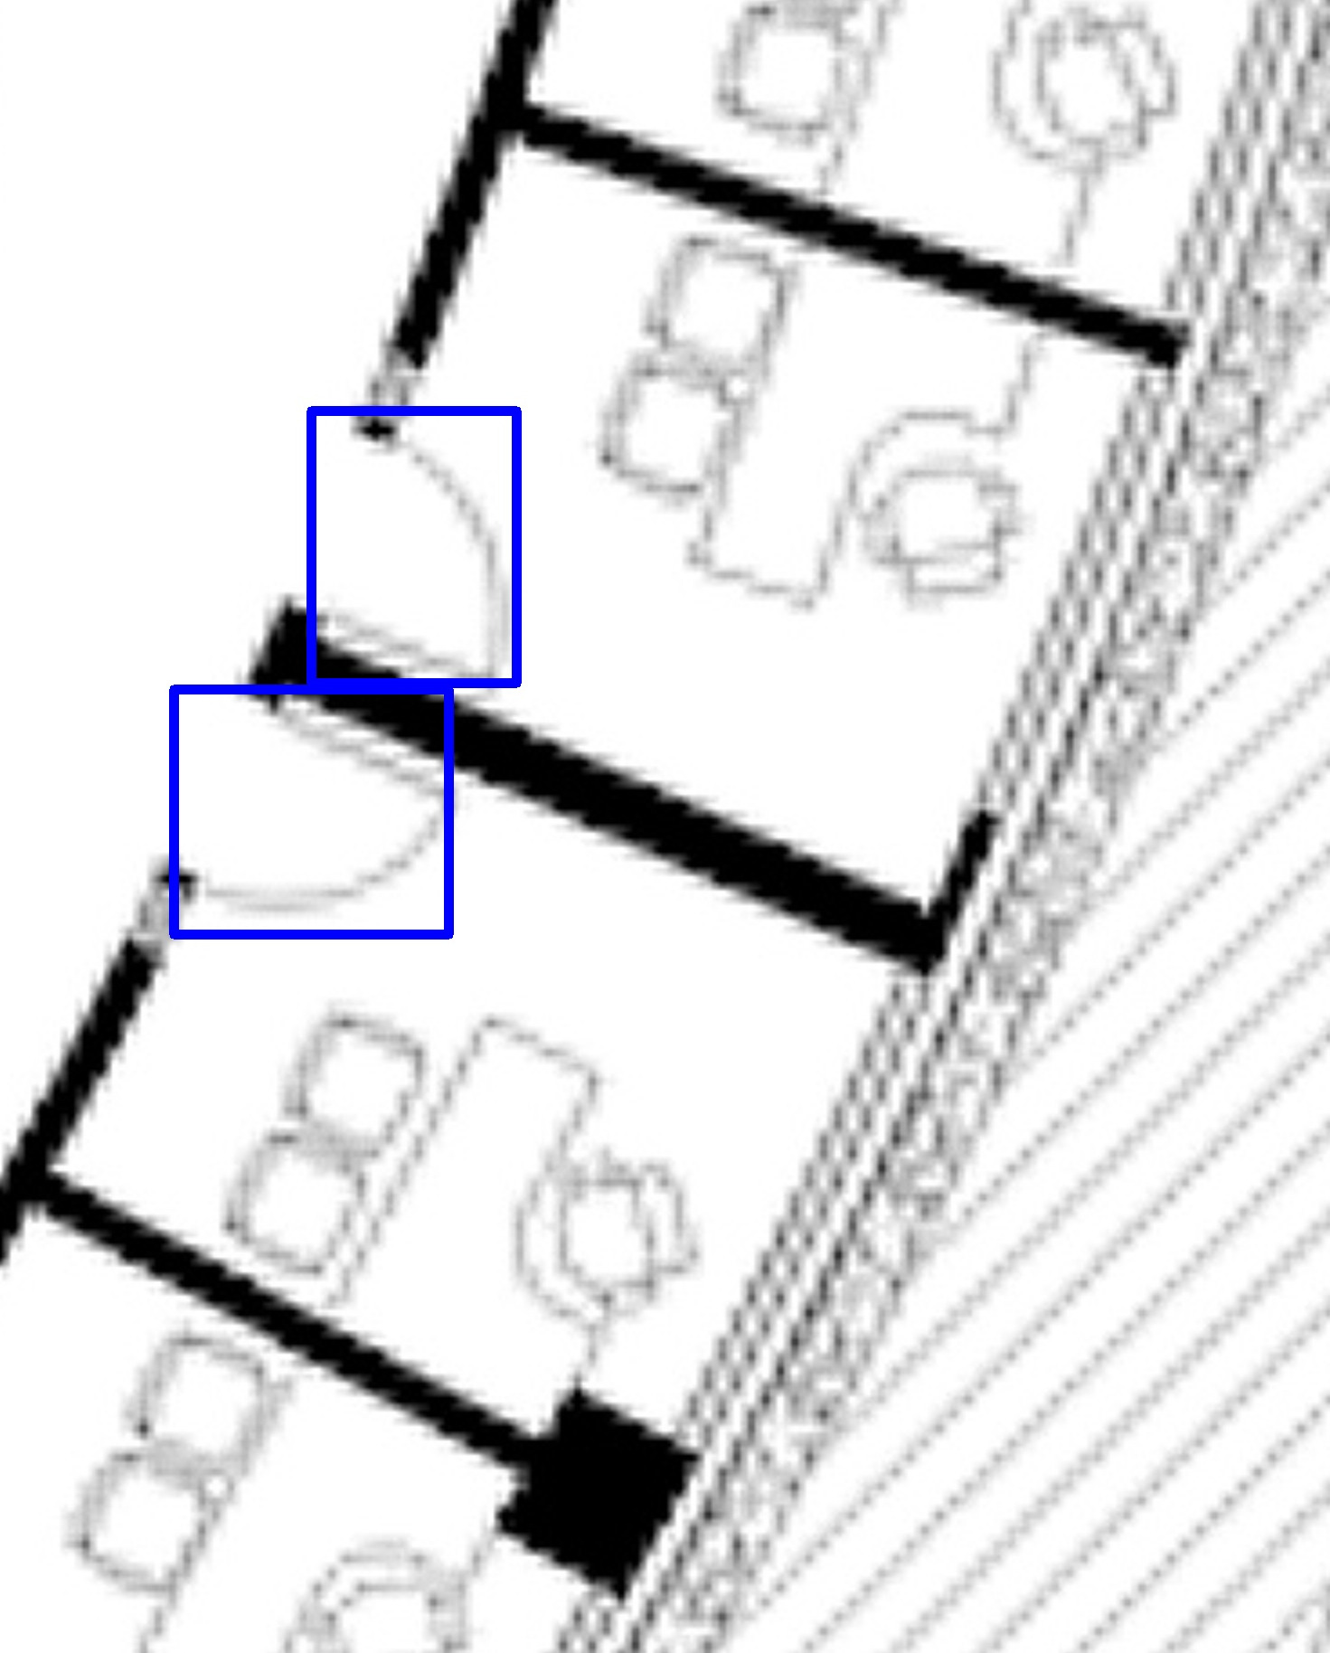



Wall Detection
Simple door bounding box removal may result in information loss
Solution: Use multi-otsu thresholding to only remove doors
After removing the doors we find the contours of the binary image to detect walls and obstacles
ARIADNE - NTUA
10

Slide 12
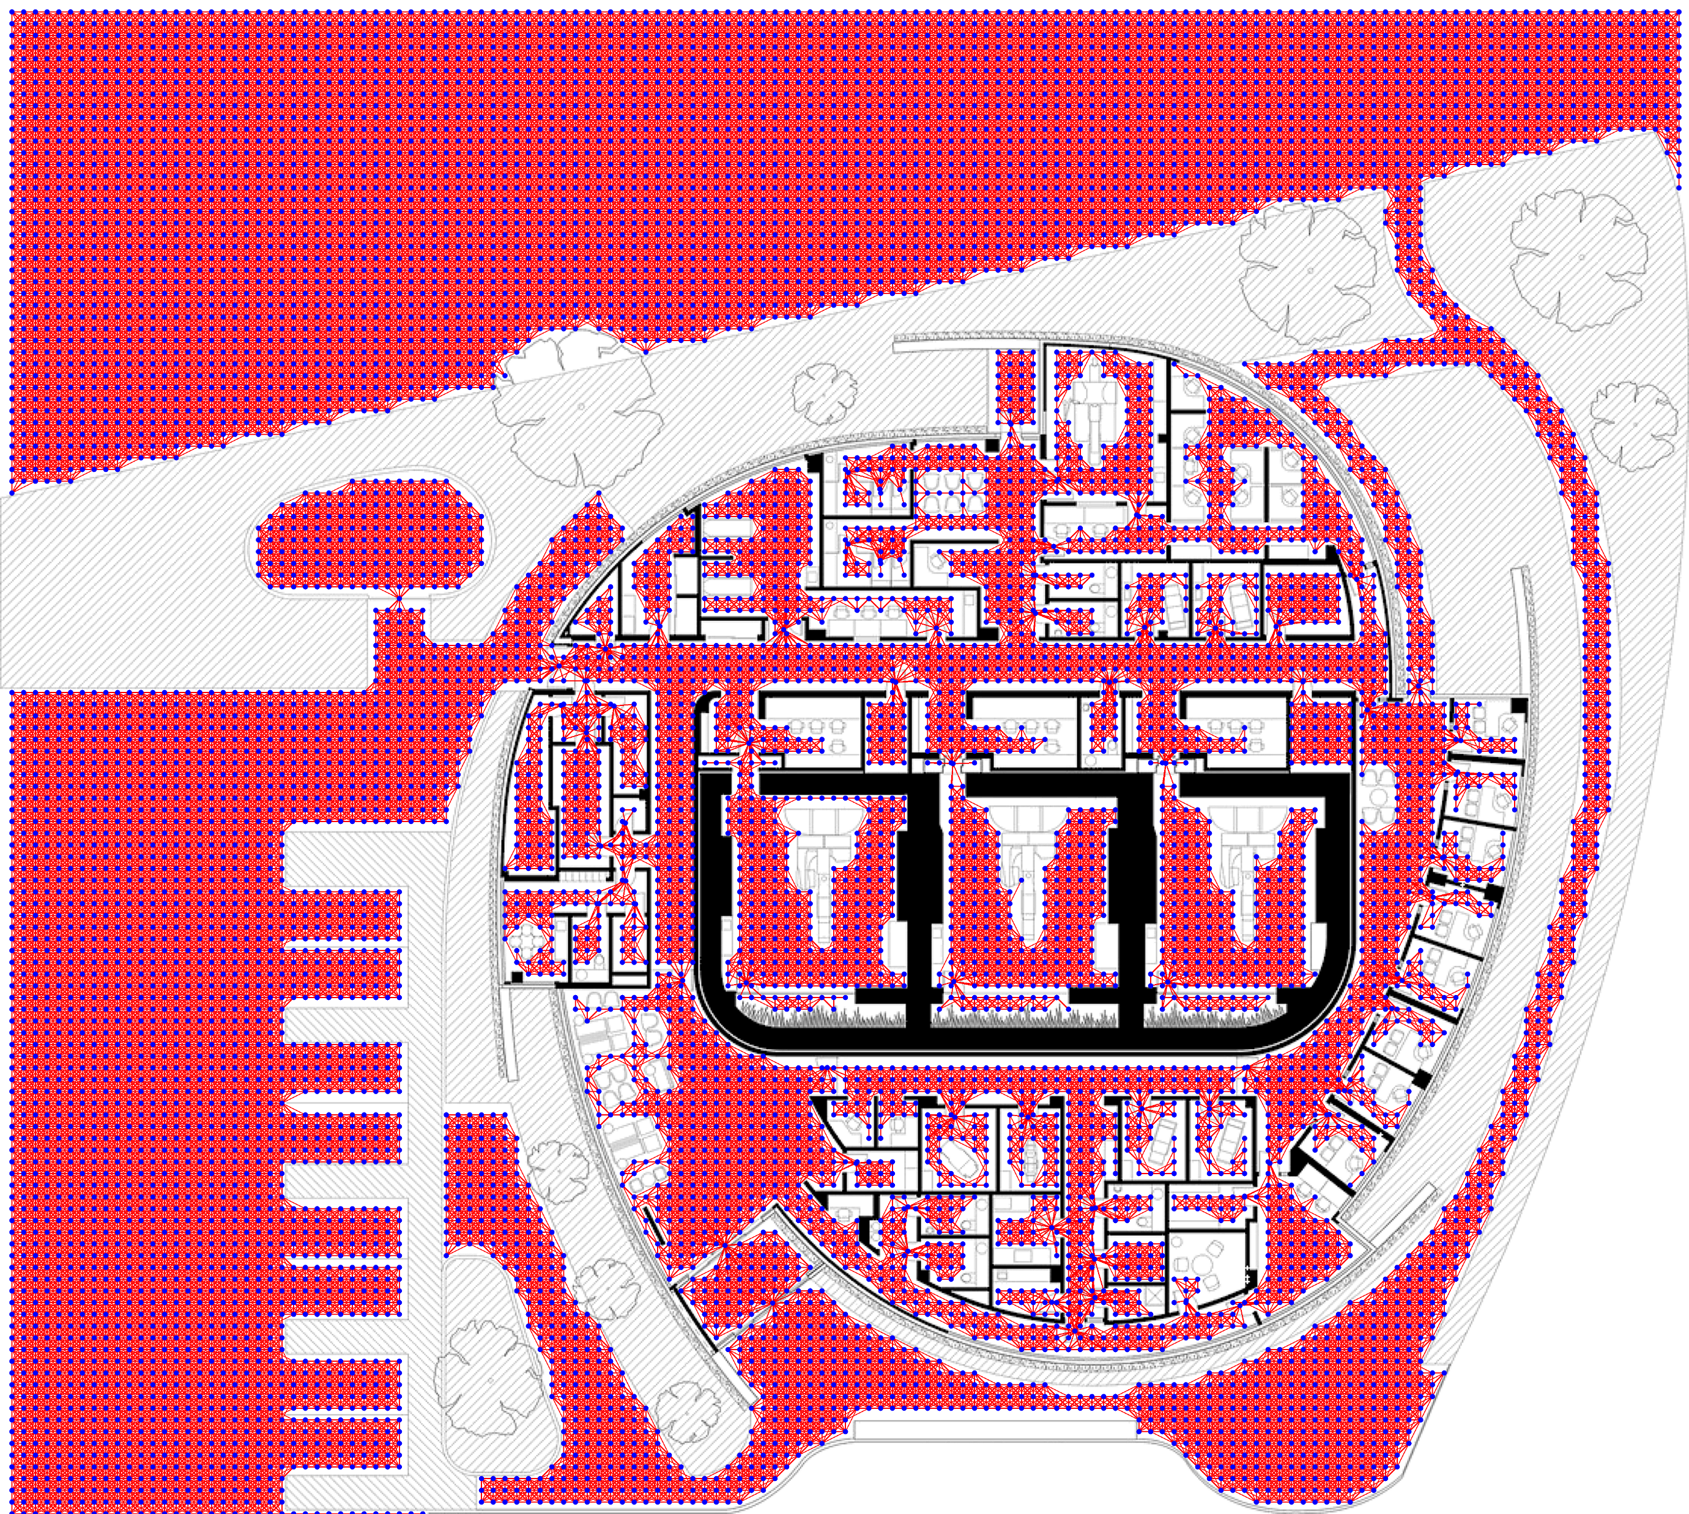
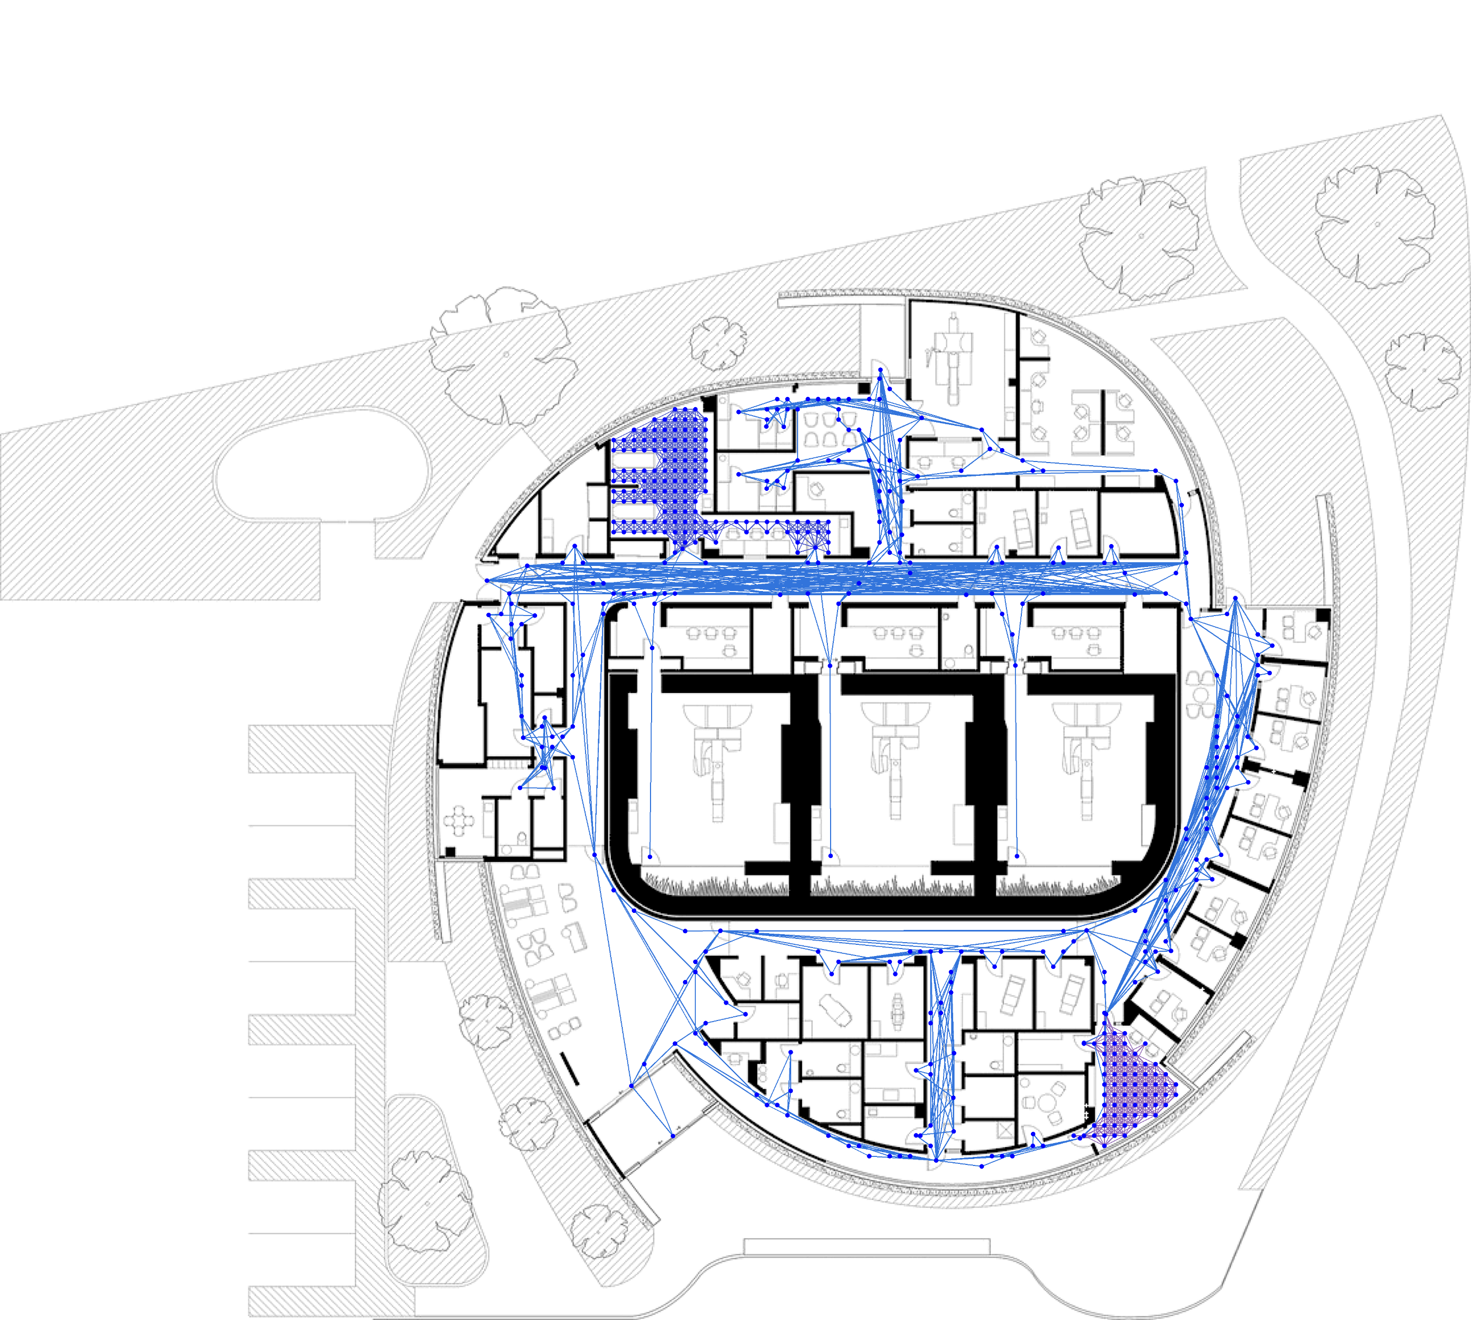
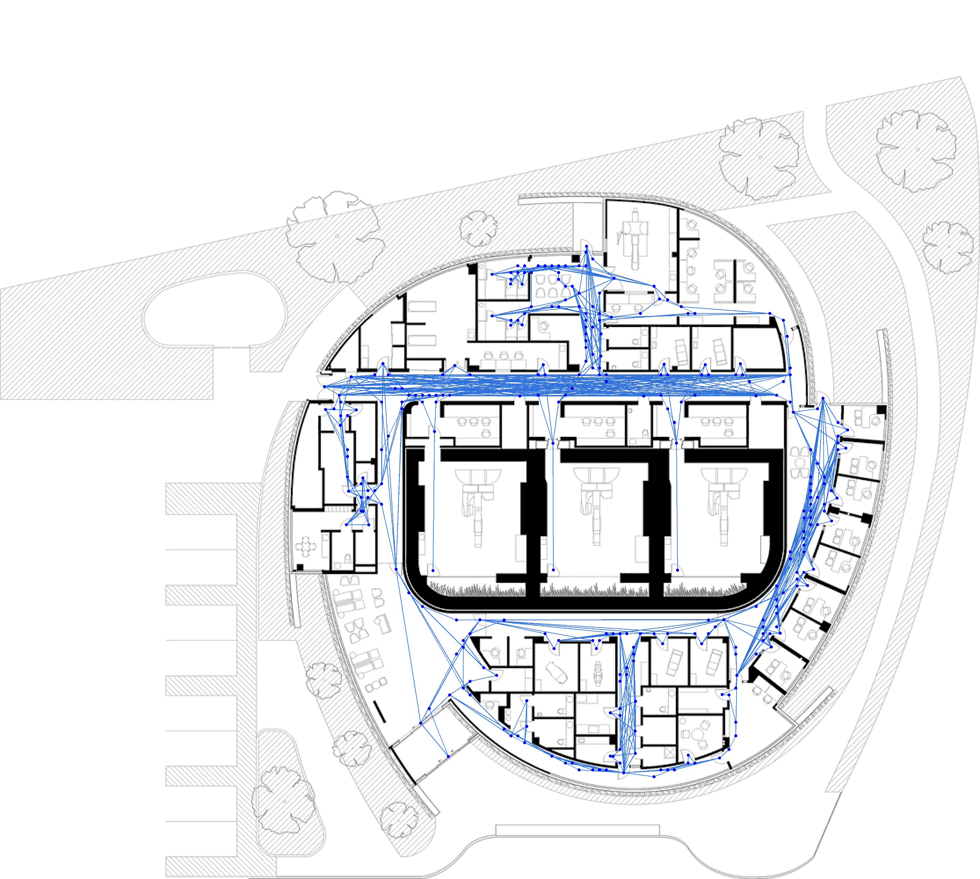
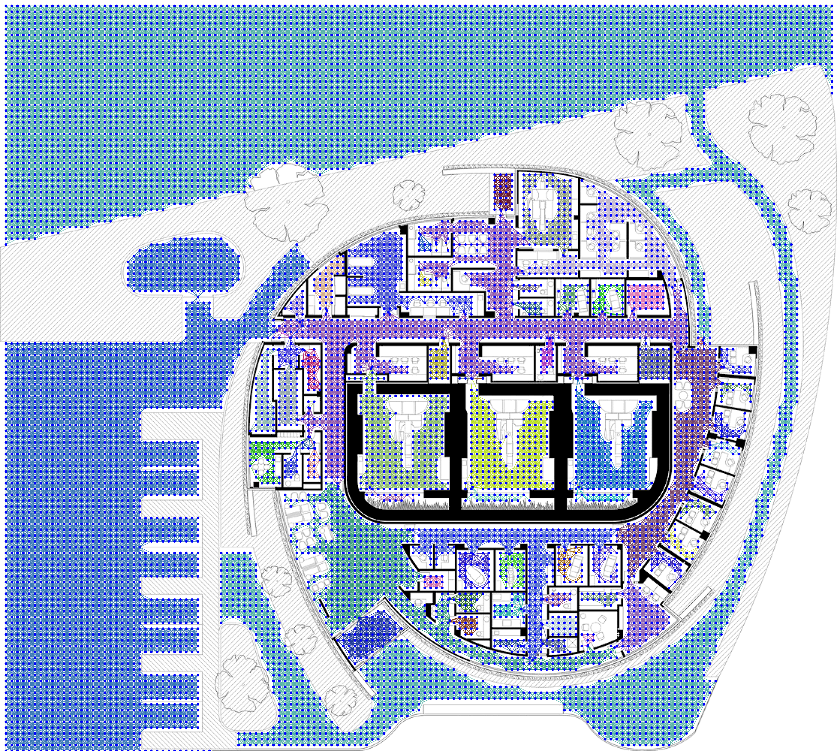
Graph Construction
Nodes: 10,000+
Edges: 70,000+
Nodes: 500
Edges: 1,800
ARIADNE - NTUA
11

Slide 13
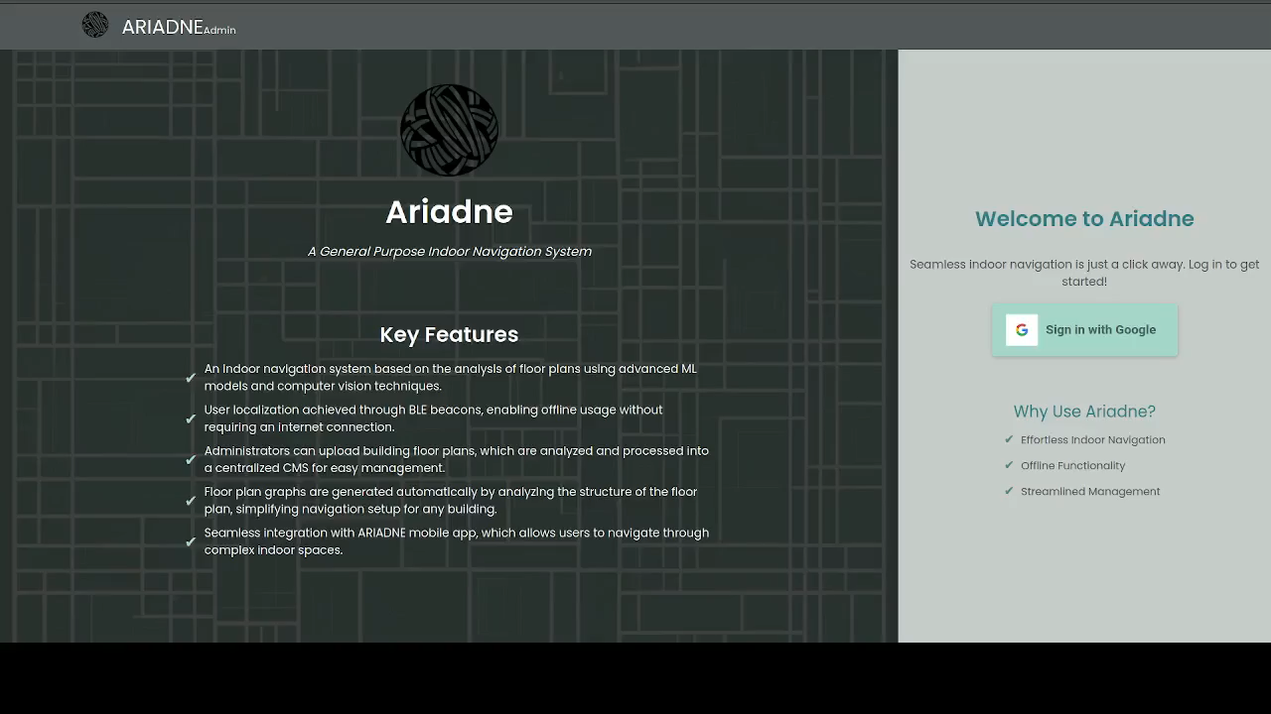
ARIADNE System Demo
ARIADNE - NTUA
12

Slide 14
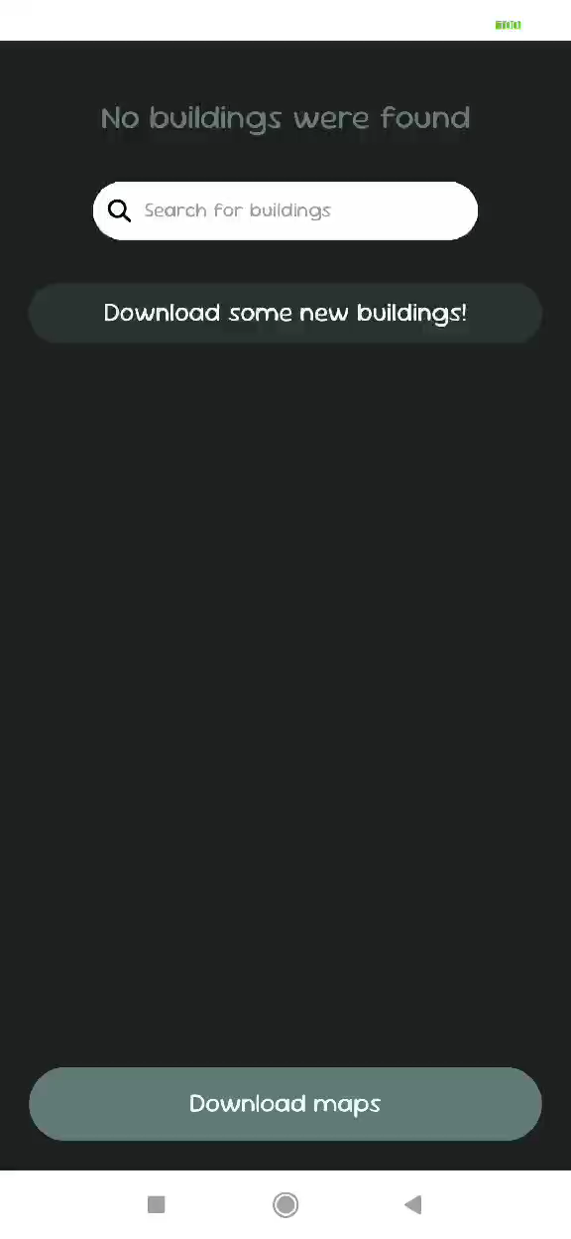
ARIADNE Mobile Application Demo
ARIADNE - NTUA
13

Slide 15
Thank you for your attention!
Athanasios Tsoukleidis-Karydakis
Dimitrios-David Gerokonstantis Dionisios Rafail Defteraios Epimenidis Kountourakis
Filippos Sevastakis Konstantinos Ioannou Maria Zerva Savvina Nastou Spyros Papadopoulos
ARIADNE - NTUA

